Slide 1
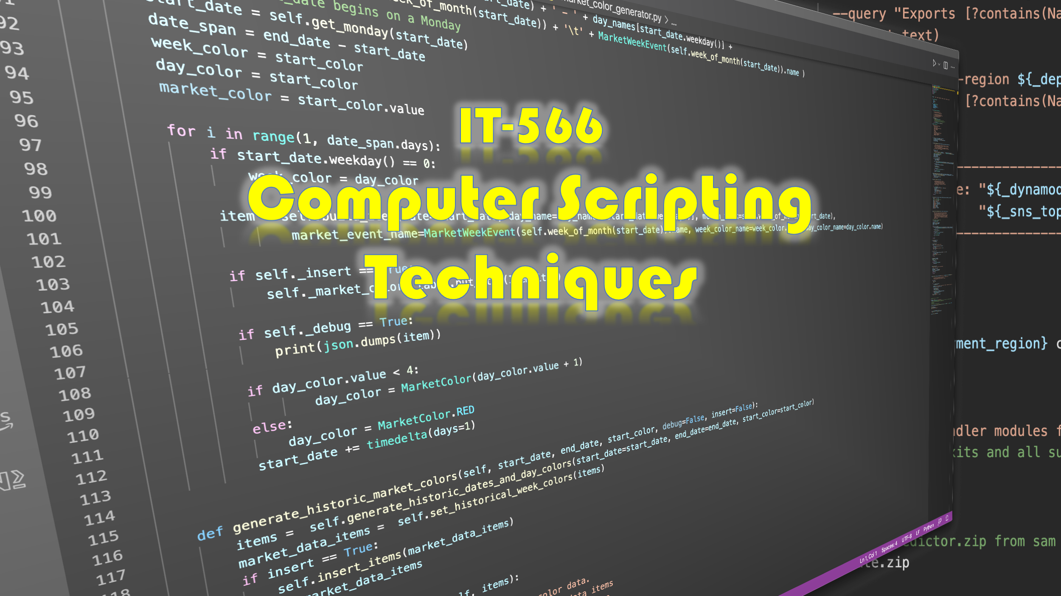

Slide 2
Week 2
Talking Points
Development Environment Setup and Configuration (Loose Ends)
Project Organization & Layout
Bash Build Script
Git Development Workflow

Slide 3
Development Environment Setup and Configuration (Loose Ends)
Package Managers
pipenv Setup, Usage & Why You Need It
tree Command
Configure ssh for GitHub
.bash_profile Helpful Settings

Slide 4
Package Managers

Slide 5

What Is A Package Manager?
An application that helps you install and manage software
GitHub, GitLab, SourceForge, PyPI, et. al.
Homebrew apt-get/apt
rpm, npm, pip, et. al.
Package Metadata
System (Windows, Linux, MacOS, Python)
Package Manager
Repository
Package
Dependencies

Slide 6
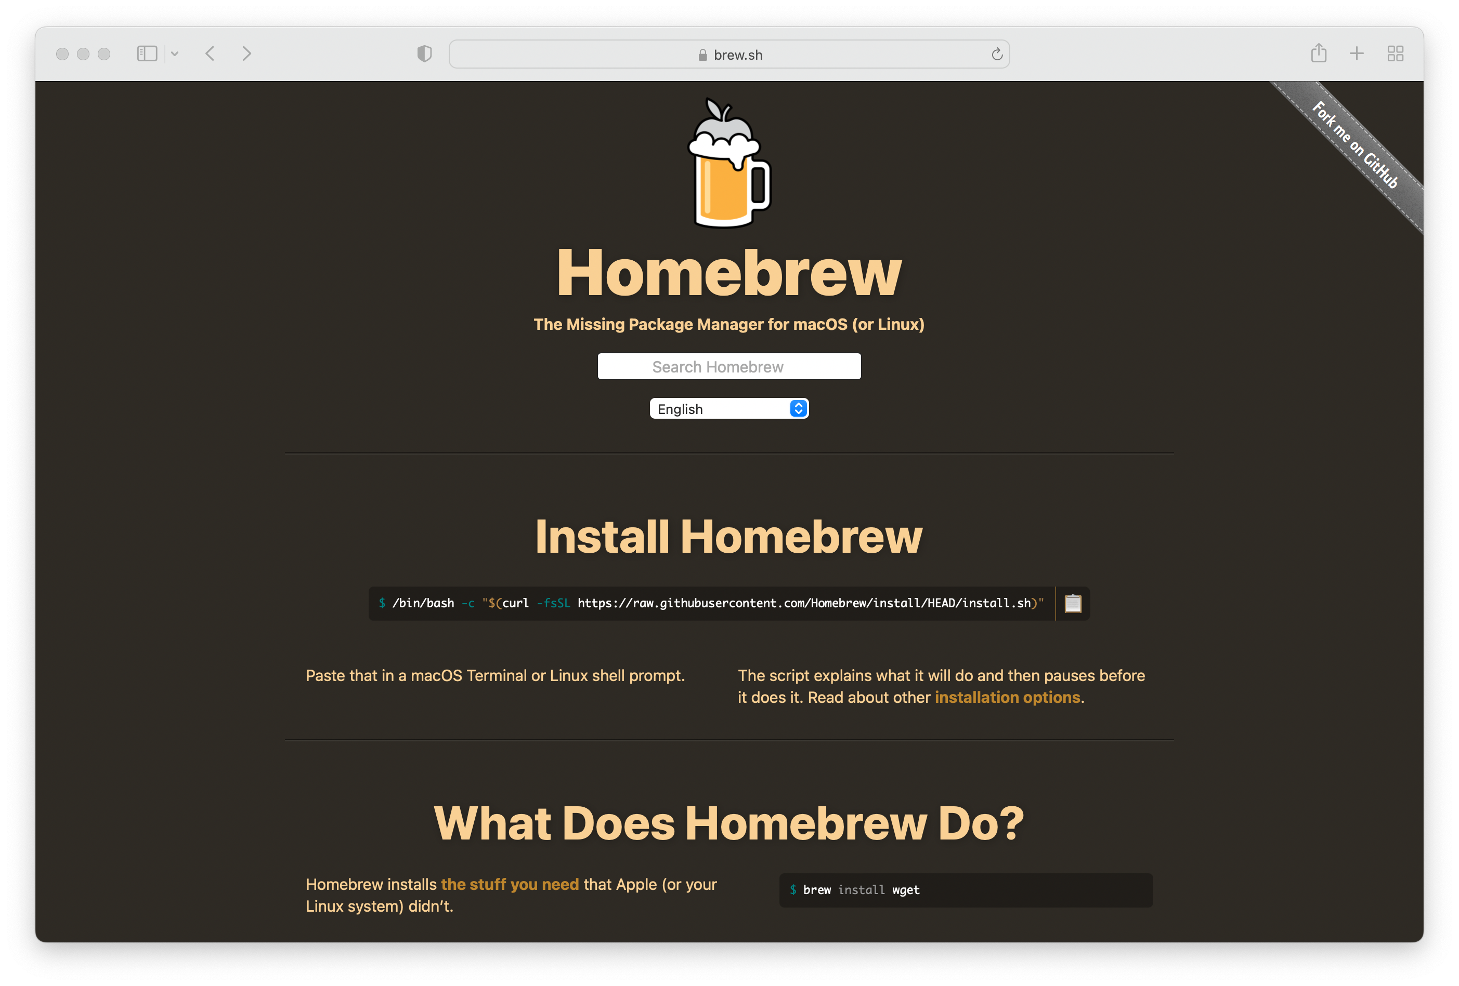
Homebrew MacOS (And Linux) Package Manager
Package Manager for MacOS
x86 & arm64
Simplifies Software Installation
Especially Unix utils
Developer tools
Linux, too
x86 (no arm64 binaries)

Slide 7

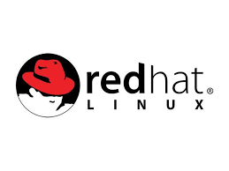



Linux Package Managers
Depends on Distribution
apt-get / apt
rpm

Slide 8
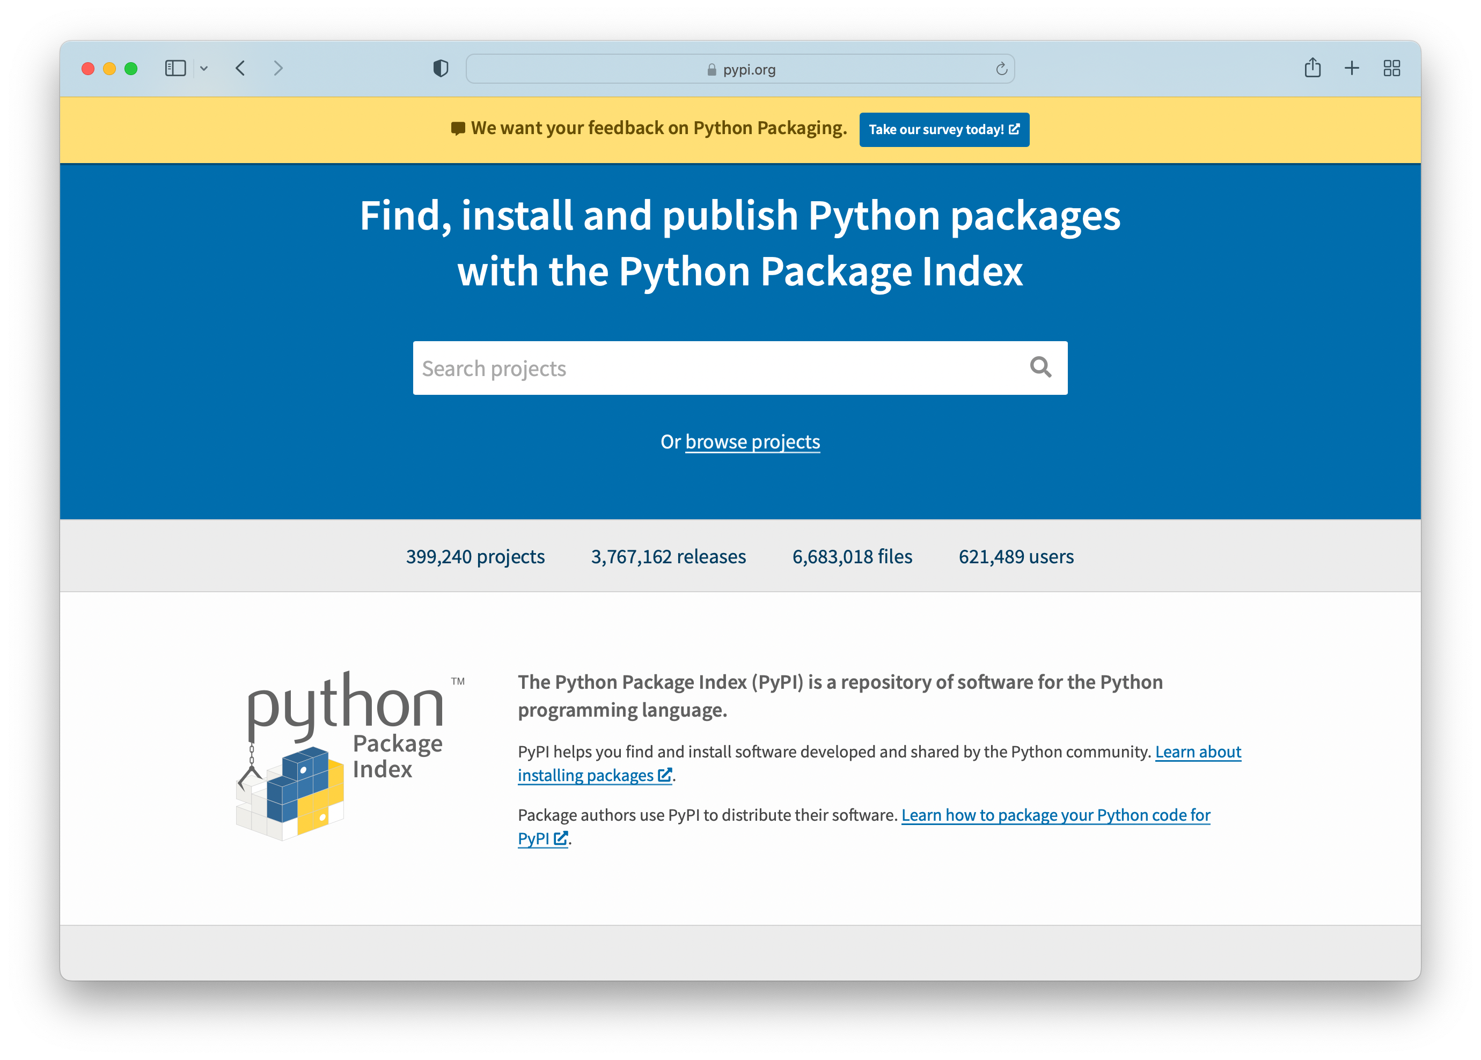
Python Package Manager — pip
pip or pip3
pip for Python 2
pip3 for Python 3
Generally…
PyPI
Python Package Index

Slide 9
pipenv Setup, Usage, & Why You Need It

Slide 10
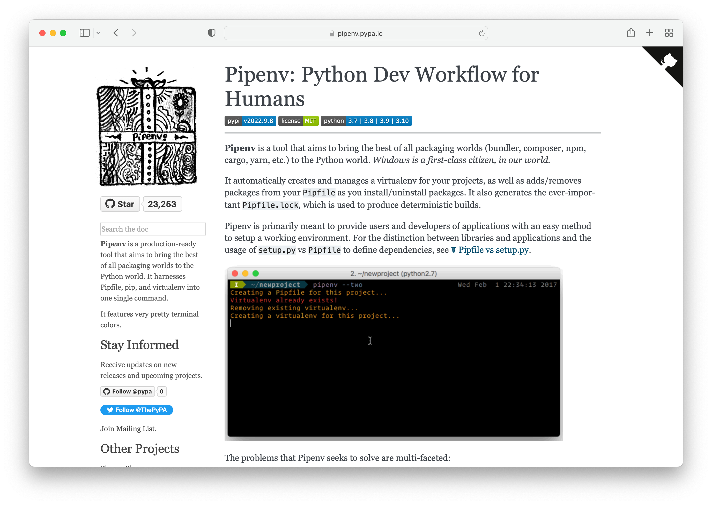
Pipenv — Why You Need It
Create and Manage Python Virtual Environments
Why?
You may have multiple python projects based on different Python versions
Helps manage and avoid python package dependency conflicts
Enables deterministic builds
With very few exceptions, avoid installing Python packages globally
Create a new venv with pipenv and install there

Slide 11
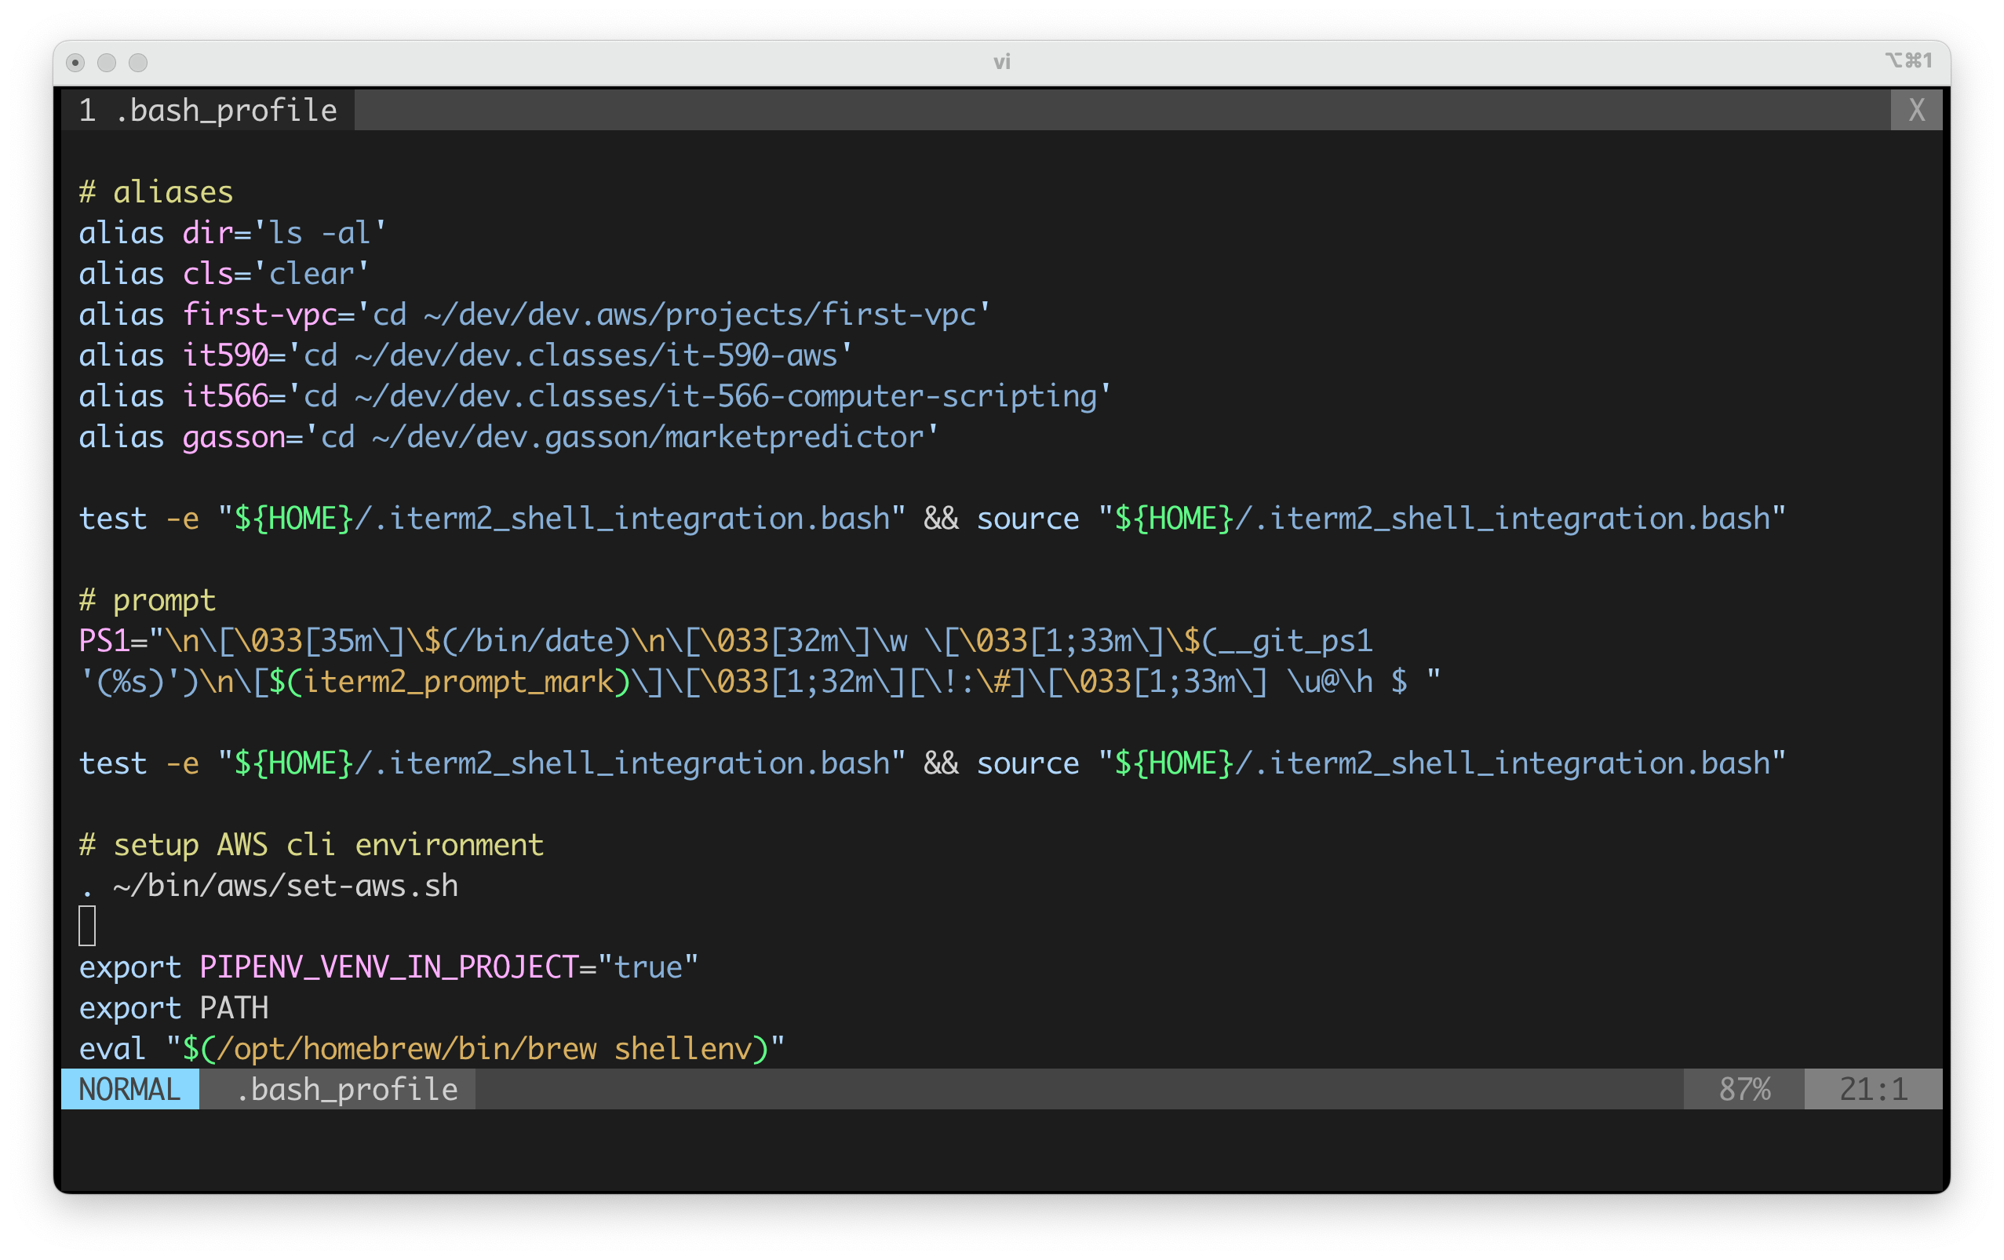
pipenv – Configuration and Usage
export the environment variable: PIPENV_VENV_IN_PROJECT=“true”
Restart shell
Usage
pipenv -- python 3
or be more specific
pipenv --python 3.6
pipenv --python 3.10
etc….
Install a package
pipenv install requests
This will create a Pipfile
…and a .venv directory

Slide 12

Oh Yeah? Show me!

Slide 13
tree Command

Slide 14
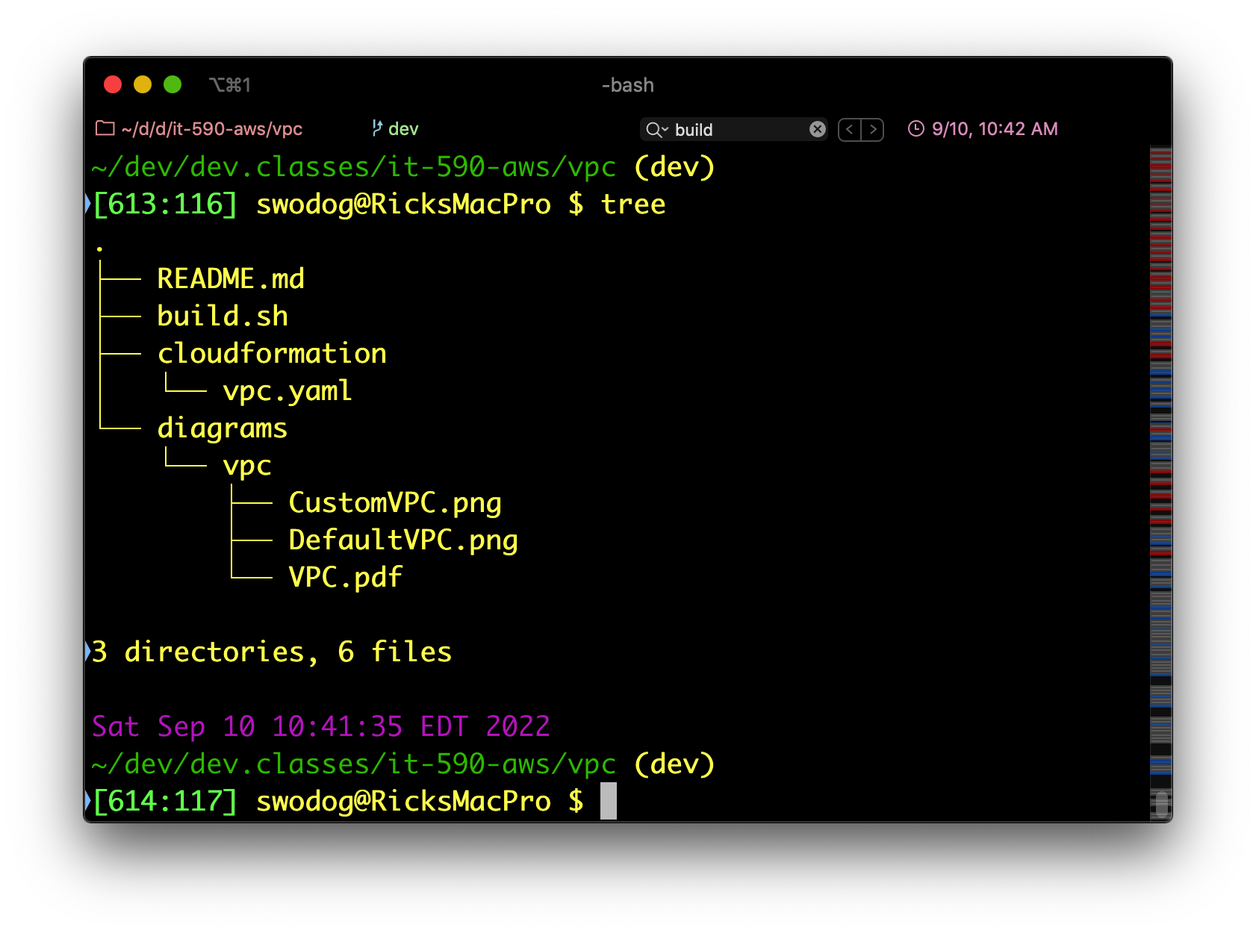
tree Command (MacOS)
Tree view of directory structure
Install with brew

Slide 15
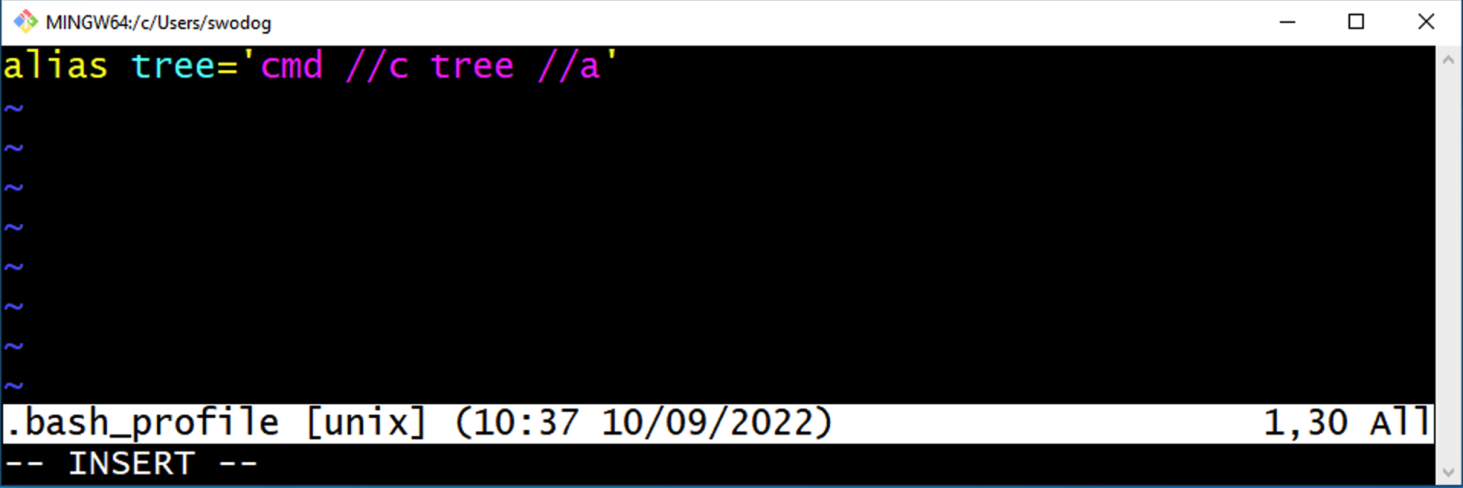
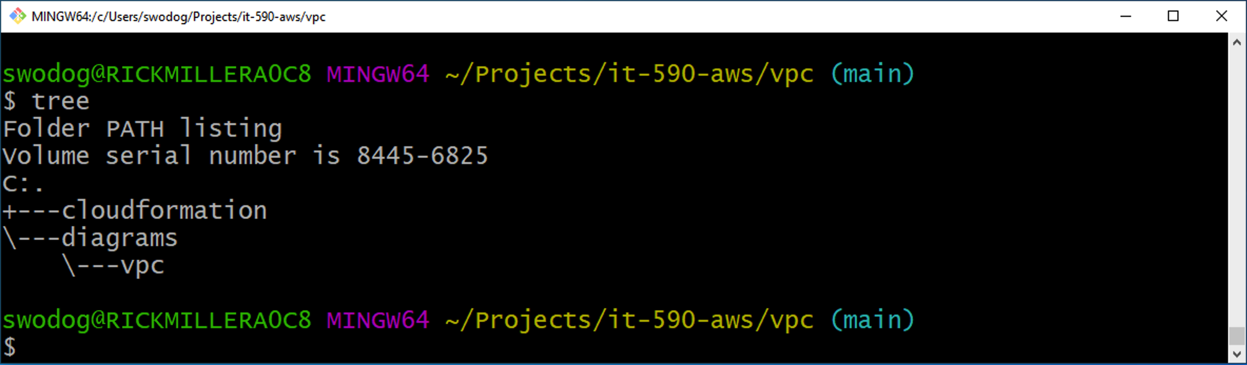
tree Command (Windows)
Add alias to tree command in .bash_profile
Comes with Windows
Must configure to use in git bash
Relaunch Git Bash

Slide 16
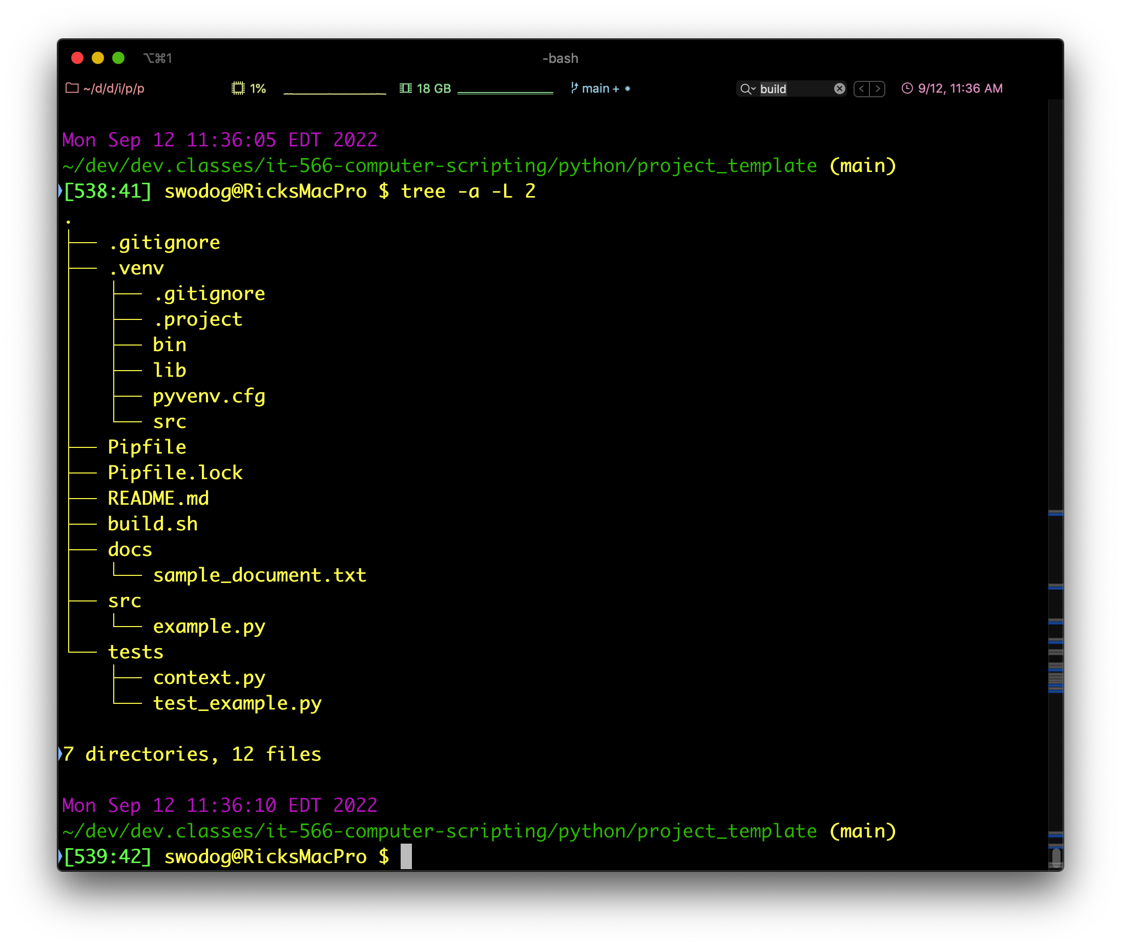
tree Command (Show Hidden Files)
tree –a –L 2

Slide 17
Really? Show me!

Slide 18
.bash_profile Helpful Settings

Slide 19
.bash_profile Helpful Settings
Command Aliases
Environment Variables
Fancy Prompt
Links to other shell scripts
Much, much, more…

Slide 20
Configure SSH for GitHub

Slide 21
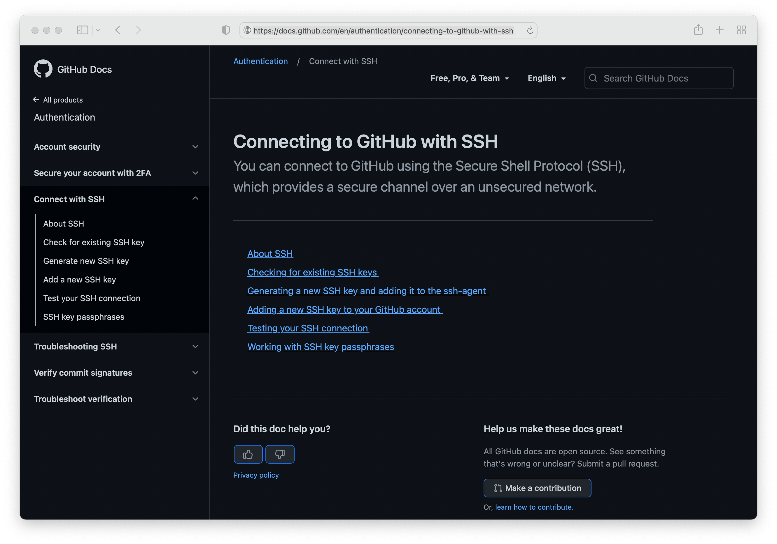
Configure SSH for GitHub
Secure Repository Connection
SSH Key Generation and Installation
Can be confusing
Let’s walk through

Slide 22

GitHub SSH Key Generation and Configuration

Slide 23
Project Organization & Layout
Directory Structure & Project Artifacts
Python Modules & Packages

Slide 24
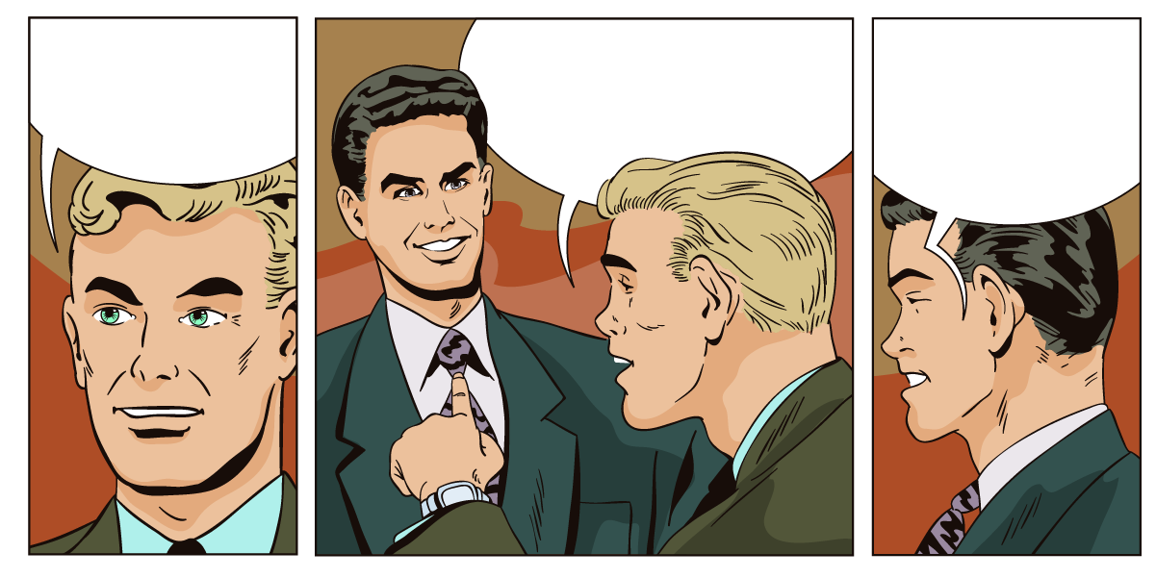
Hey Bill, me and Beth are having relationship issues. What do you think I should do?
There’s Bill, I’ll ask him…
Fix your Python project structure!

Slide 25
Project Organization
Project Organization Refers to Several Issues
Directory Structure and Layout
Source Code Organization
Module and Package Organization
Application Architecture
Today — Focus on Directory Structure and Project Artifacts
Later Today — Focus on Application Architecture
…and how to organize source code into modules and packages

Slide 26
Directory Structure & Project Artifacts

Slide 27
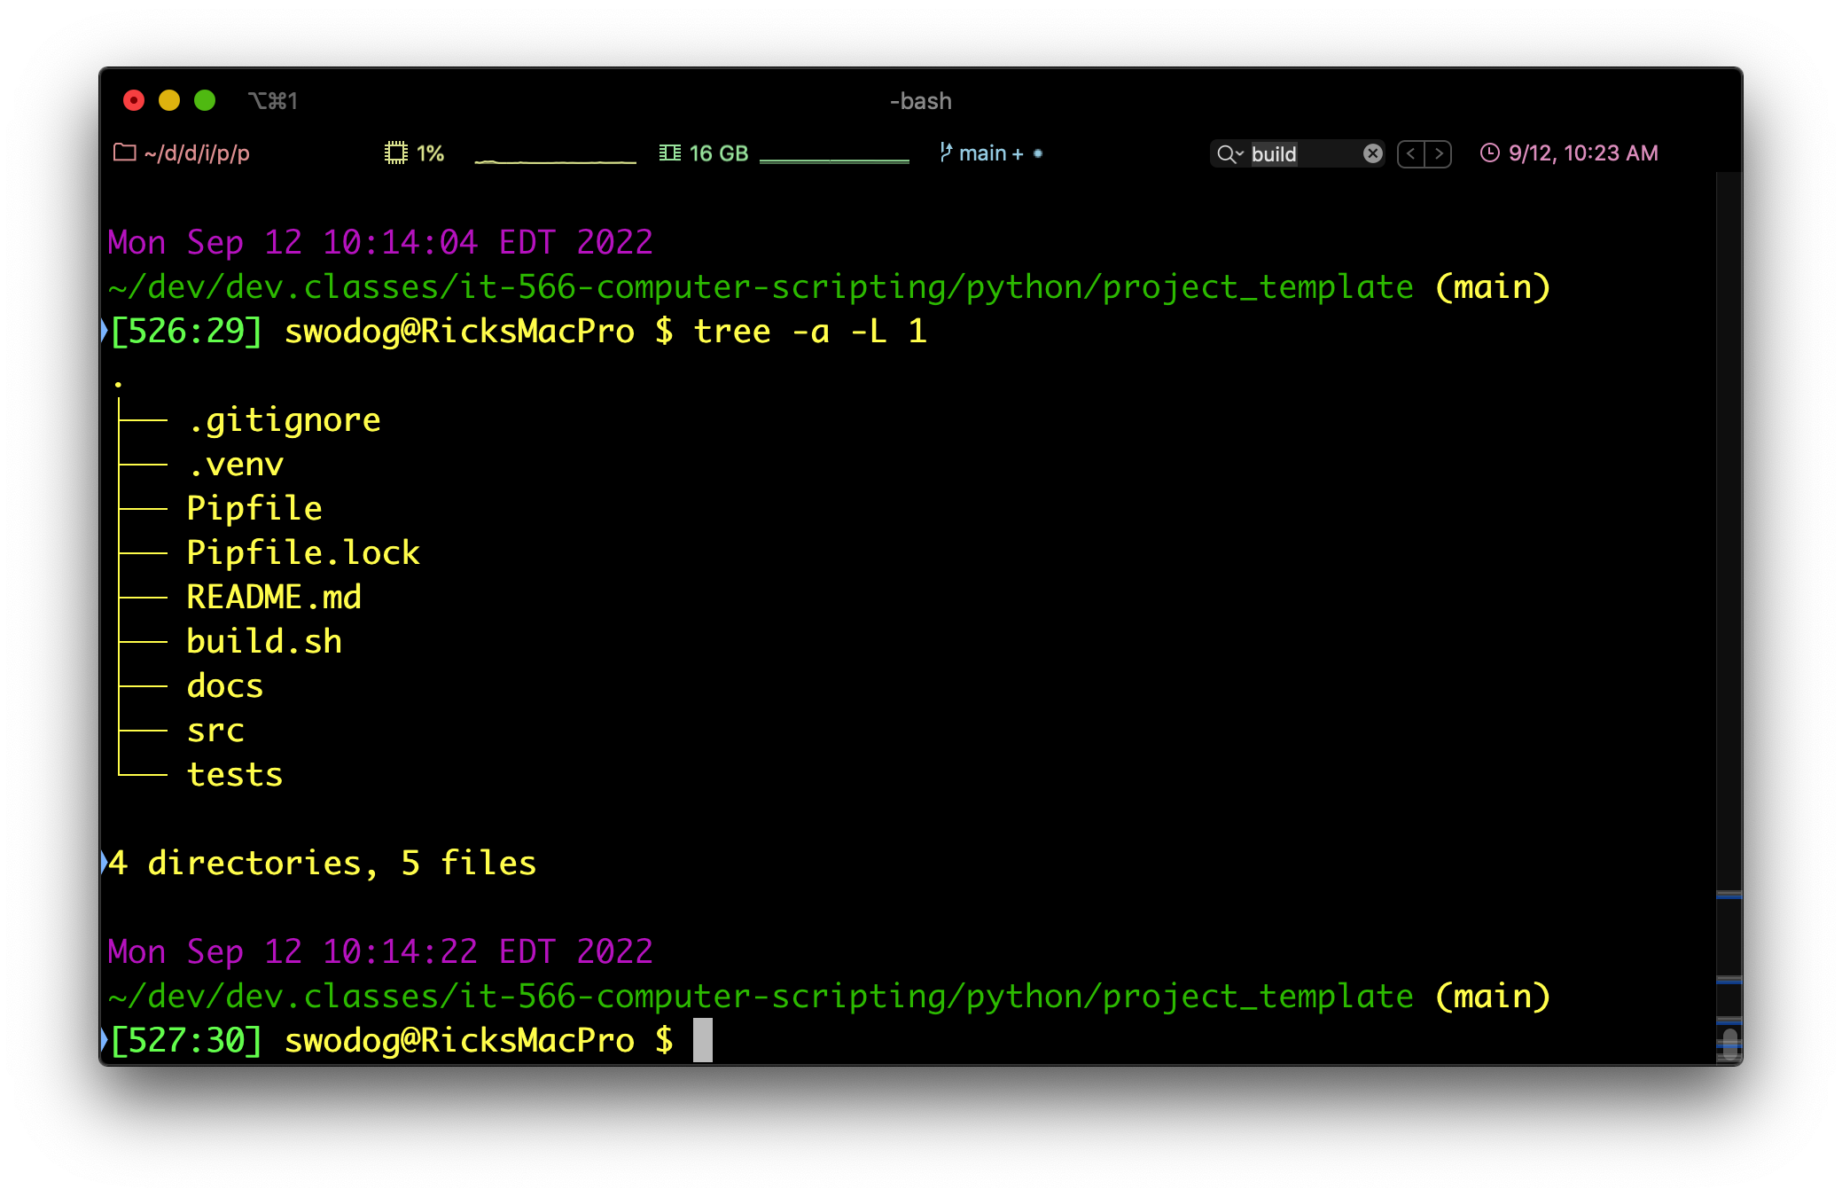
Directory Structure and Project Artifacts
.gitignore — List of files not to add to repo
.venv — Virtual Environment created by pipenv
Pipfile — List of required project packages
Pipfile.lock — List of specific package versions
README.md — Markdown document displayed by GitHub
build.sh — Bash build file
docs — Documentation directory
src — Python source code directory
tests — Unit and integration tests directory

Slide 28
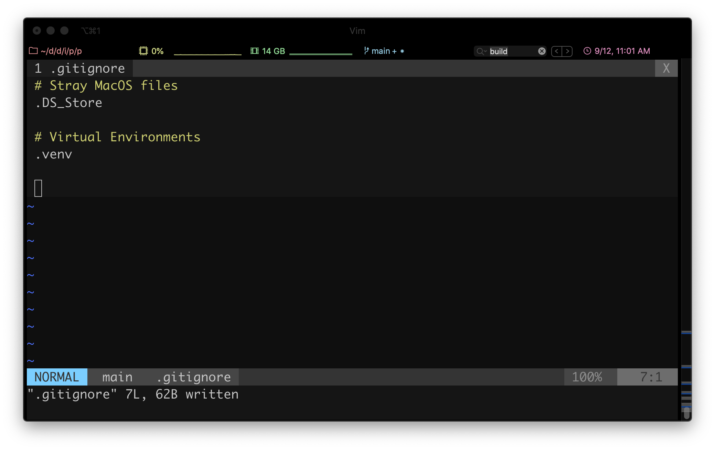
.gitignore
List files and directories to ignore
Can add when creating repo in GitHub
This is a very simple example
I like to start simple…
And add items as I go
Let’s see a complete python .gitignore

Slide 29
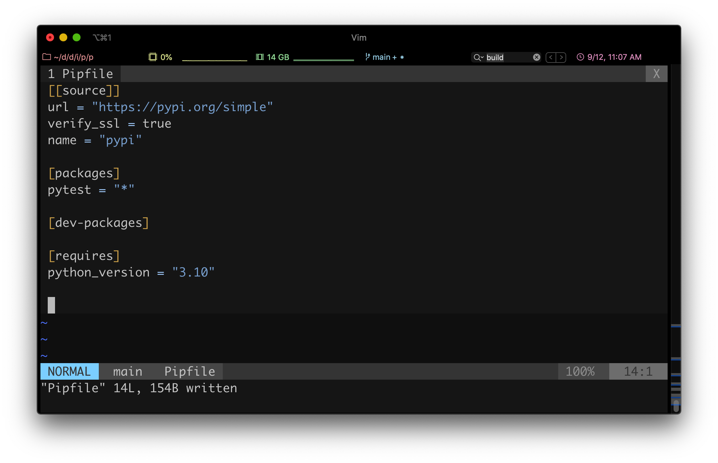
Pipfile
Lists repository source
Installed packages
Production
Development
I need to fix pytest
Should be in [dev-packages] section
And required Python version

Slide 30
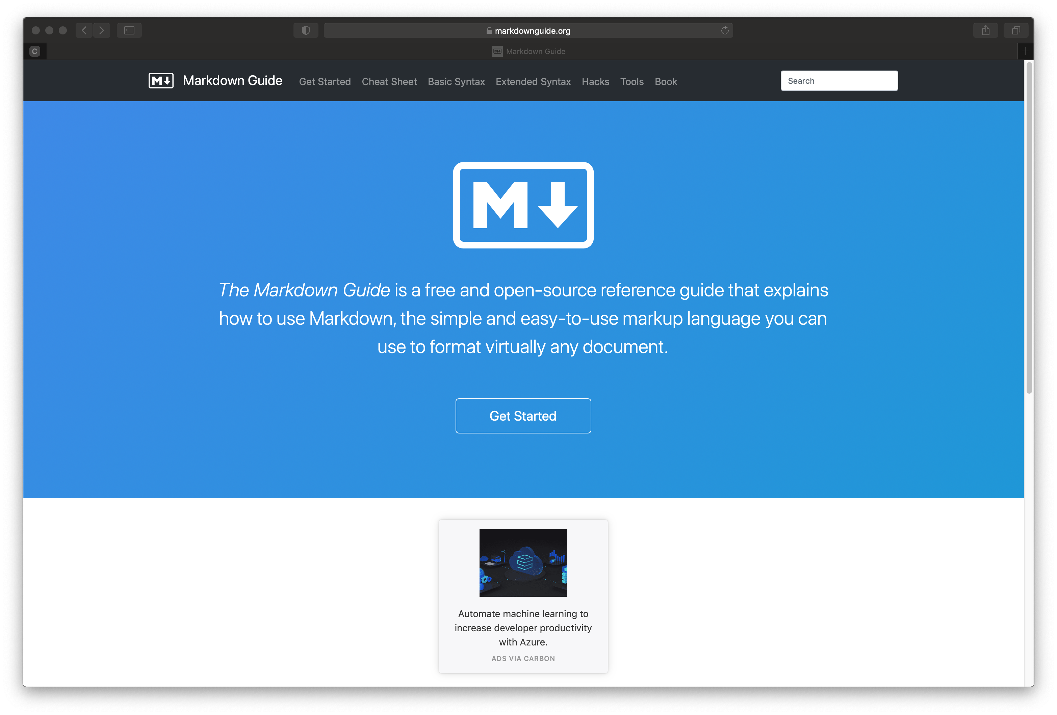
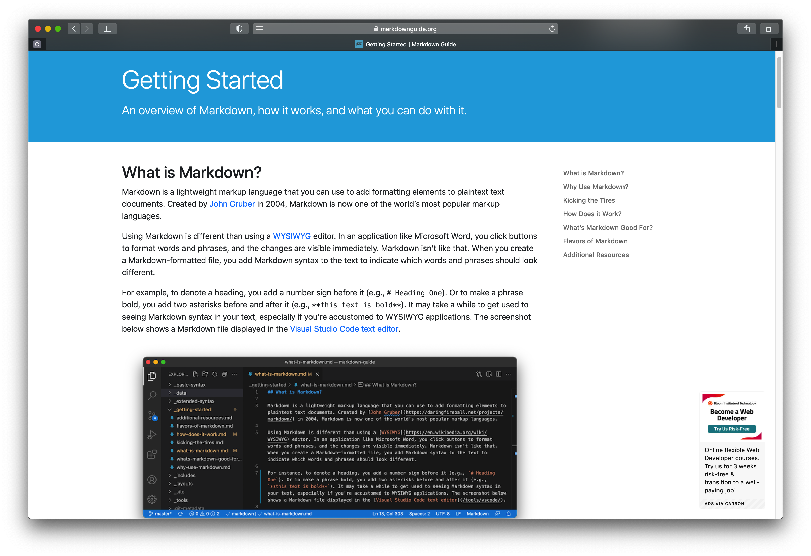
README.md
Markdown File
https://www.markdownguide.org

Slide 31
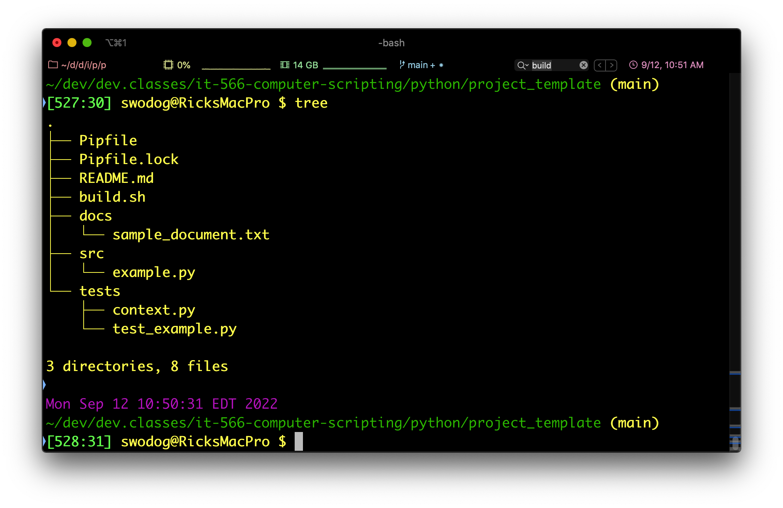
Directory Structure and Project Artifacts
Python source files go in src directory
Python unit and integration tests go in tests folder
context.py simplifies Python module and package location for unit tests

Slide 32
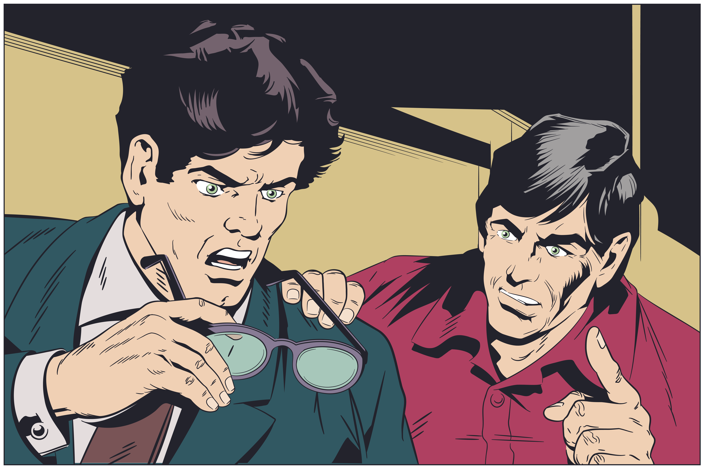
Maybe they won’t notice…
Hey, not so fast. What about the Pipfile.lock?

Slide 33
Python Modules and Packages

Slide 34

Python Modules and Packages
https://docs.python.org/3/reference/import.html#namespace-packages
src
sourcefile_1.py
package name
__init__.py
sourcefile_2.py
sourcefile_3.py

Slide 35
Bash Build Script

Slide 36
Bash Build Script (build.sh)
Simplifies Project Management
Consolidate Complex Commands
Let’s take a look…

Slide 37
Git Development Workflow

Slide 38
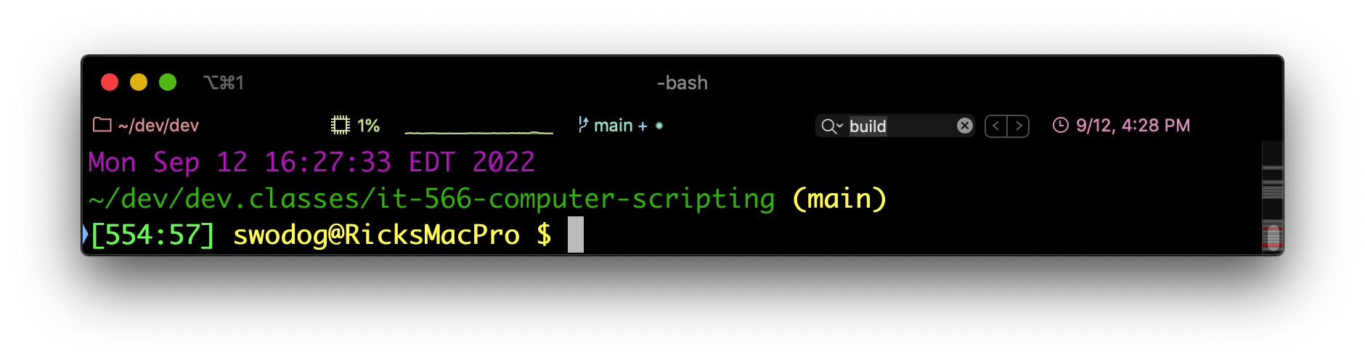
Git Development Workflow
Initial Activities
Create GitHub Repository
Add README.md and .gitignore
You will either start with a main or a master branch
Clone The Repository Locally
git clone git@github.com:repository_name.git
Example: git clone git@github.com:pulpfreepress/it-566-computer-scripting.git

Slide 39
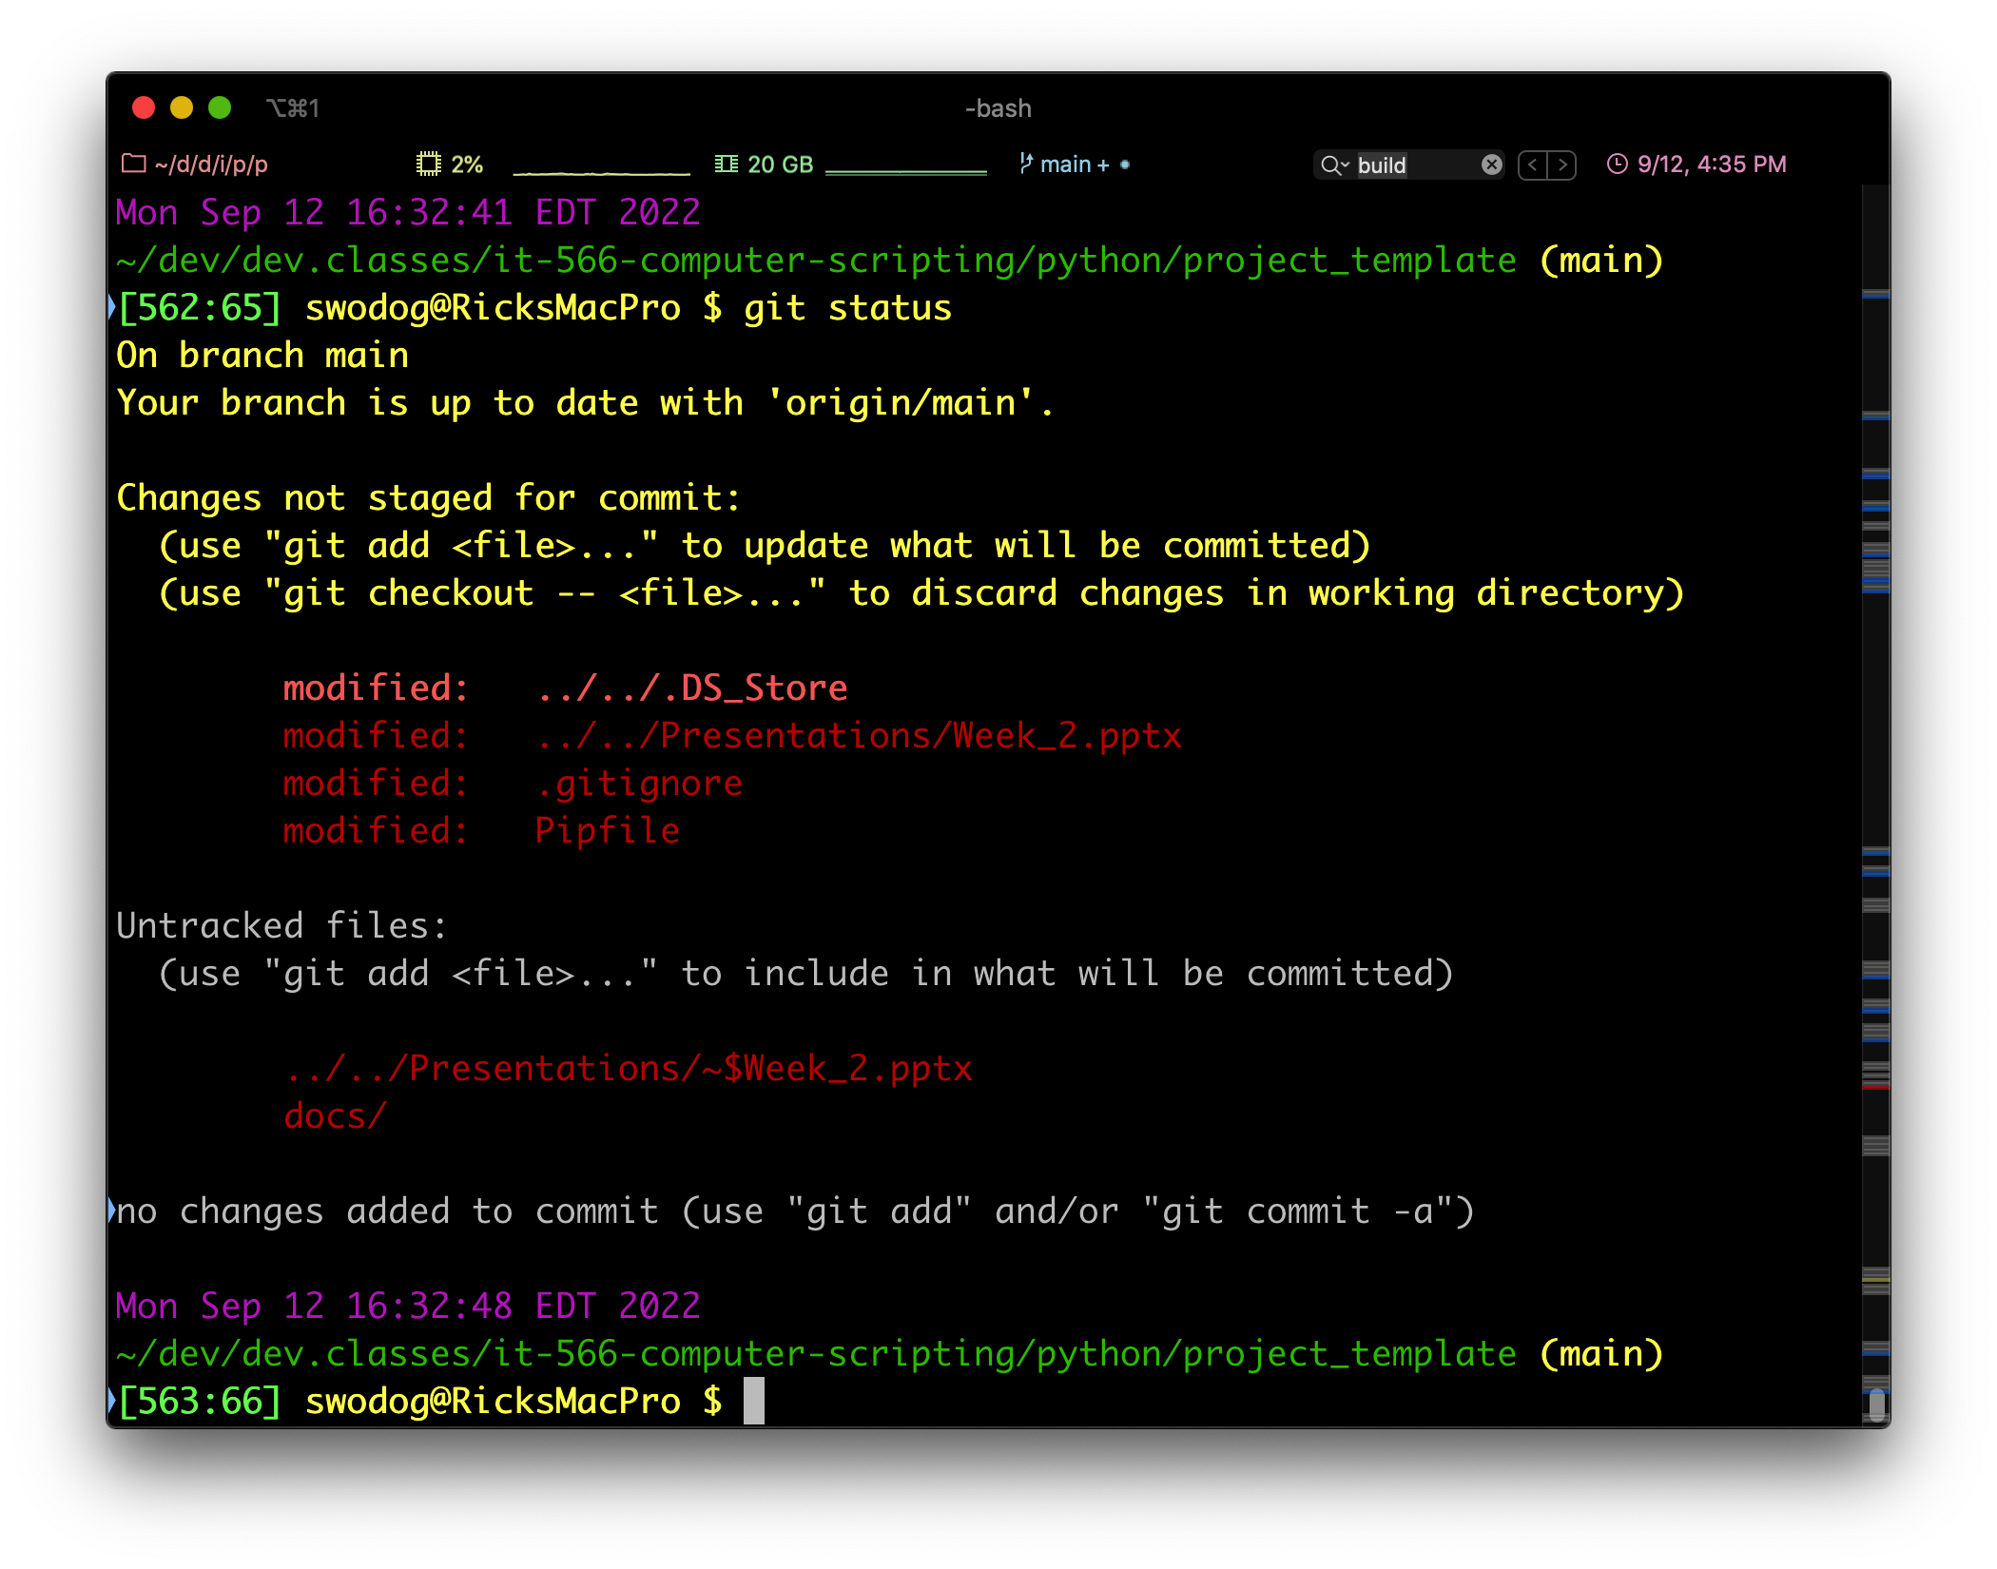
Git Development Workflow
Add, Modify, Delete Files and Directories
Check Status with git status
Followed by:
git add .
git commit –m “commit message”
git push

Slide 40

Would you like to see a demo?
Yes darling!

